Slide 1
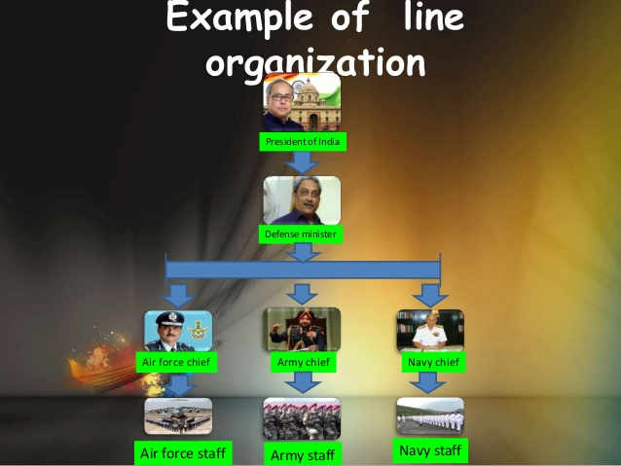

Slide 2
President of India : Hon’ble Pranab Mukherjee
Defense Minister : Hon’ble Manohar Parrikar
Air Chief Marshal : Hon’ble Arup Raha
Army Chief : Hon’ble General Dalbir Singh Suhag,
Navy Chief : Hon’ble Sunil Lanba

Slide 3
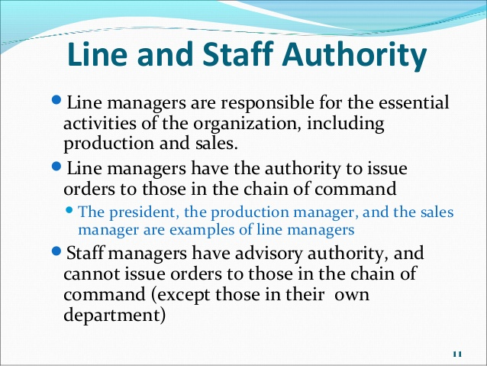
Line and Staff Organization

Slide 4
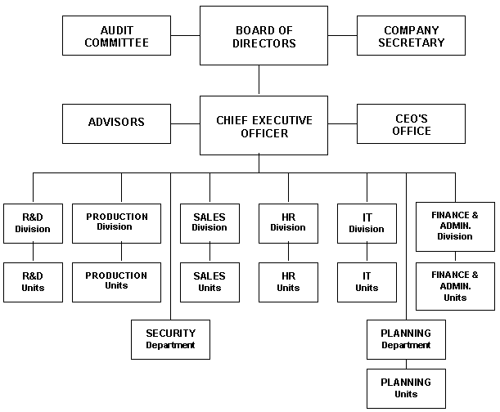
Functional Organisation

